Slide 1
Introduction to Ajax and JSON
Lesson 1 : JSON

Slide 2

Lesson Objectives
To understand the following topics:
  Introduction
  What is JSON ?
  Why JSON ?
  Using JSON
    Working with JSON and JavaScript
    JSON.stringify and JSON.parse
Notes:
Lesson 1:
1 JSON and Dojo
1.1 JSON(JavaScript Object Notation)
3.1.1 Data interchange using JSON
Explain the lesson coverage which is specified in notes pages in more details.

Slide 3
Introduction
JSON (JavaScript Object Notation), is a simple and easy to read and write data exchange format.
It’s popular and implemented in countless projects worldwide, for those don’t like XML, JSON is a very good alternative solution.

Slide 4
What is JSON ?
JSON is a lightweight text-based open standard data-interchange format.
You can read and write JSON easily.
JSON is derived from a subset of JavaScript programming language (Standard ECMA-262 3rd Edition—December 1999).
It is entirely language independent and can be used with most of the modern programming languages.
JSON files are saved with .json extension.
Internet media type of JSON is "application/json".

Slide 5
What is JSON ?
Language Independent
Text-based
Light-weight
Easy to parse
Not a document format
In JSON a data structure is a key / value pair. The key is a string, the value can be a numerical value, a boolean value (true or false) or an object
Lists are one or more values surrounded by [] and separated by ","
An object is a set of key / name pairs which starts with "{" and ends with "}".

Slide 6
JavaScript Object Notation (continued…)
An example JSON might look like the following.
{
firstName:'Lars',
lastName:'Vogel',
address: {
street:'Examplestr.',
number: '31'
}
}

Slide 7
JavaScript Object Notation (continued…)
The following is an example of an JSON object and its usage in JavaScript. You evaluate the JSON via the function eval and can then assign it to an object. This object can then be used in your JavaScript source code.
<!DOCTYPE HTML PUBLIC "-//W3C//DTD HTML 4.01 Transitional//EN"> <html>
<body>
<script type="text/javascript">
<!--Evaluate the object and assign to variables -->
var user = { firstName:'Lars', lastName:'Vogel', address: { street:'Examplestr.', number: '31' } };
<!--Use the object-->
alert(user.firstName + ' lives in street ' + user.address.street);
document.writeln(user.firstName + ' ' +user.lastName);
</script>
</body>
</html>

Slide 8
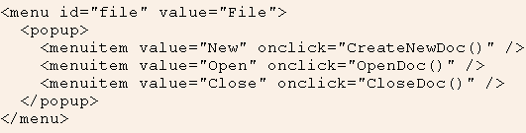
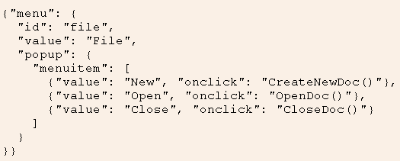
XML vs JSON

Slide 9
Why JSON ?
Because JSON is easy to write. It is just like creating and accessing class in javascript in object notation
If you like HashTables, you will fall in love with JSON.
It is easy to understand and can be integrated in any web application very easily .
Better organized data if prepared in well mannered way.
JSON is very fast.
JSON (JavaScript Object Notation) is an independent data exchange format.

Slide 10
Using JSON
Data interchange using JSON
  The key idea in Ajax
  An alternative to page replacement
  Applications delivered as pages
  How should the data be delivered ?

Slide 11
Using JSON
Data Formats
  Ad Hoc
  Database Model
  Document Model
  Programming Language Model

Slide 12
Values supported by JSON
Strings
Numbers
Booleans
Objects
Arrays
null

Slide 13
Strings
Sequence of 0 or more Unicode characters
No separate character type
  A characters is represented as a string with a length of 1
Wrapped in "double quotes“
Backslash escapement

Slide 14
Numbers
Integer
Real
Scientific
No octal or hex
No NaN or Infinity
  Use null instead

Slide 15
Booleans
true
false

Slide 16
null
A value that isn't anything

Slide 17
Object
Objects are unordered containers of key/value pairs
Objects are wrapped in { }
, separates key/value pairs
: separates keys and values
Keys are strings
Values are JSON values
  struct, record, hashtable, object

Slide 18
Object
{
"name": "Jack B. Nimble",
"at large": true,
"grade": "A",
"format": {
"type": "rect",
"width": 1920,
"height": 1080,
"interlace": false,
"framerate": 24
}
}

Slide 19
Array
Arrays are ordered sequences of values
Arrays are wrapped in []
, separates values
JSON does not talk about indexing.
  An implementation can start array indexing at 0 or 1.

Slide 20
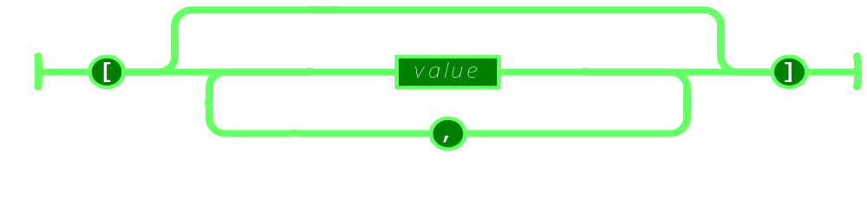
Array

Slide 21
Array
["Sunday", "Monday", "Tuesday", "Wednesday", "Thursday", "Friday", "Saturday"]
[
  [0, -1, 0],
  [1, 0, 0],
  [0, 0, 1]
]

Slide 22
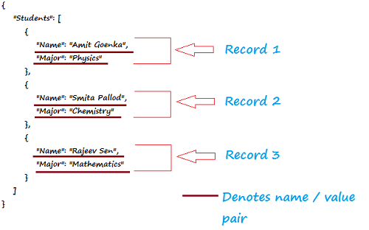
Array

Slide 23
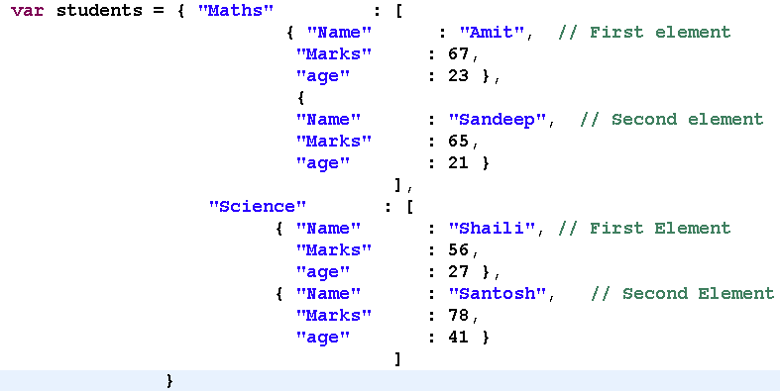
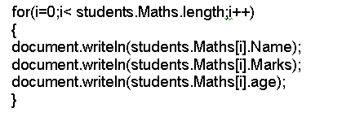
Working with JSON and JavaScript

Slide 24
Working with JSON and JavaScript
Extracting information
var myJSONObject = {"bindings": [
{"ircEvent": "PRIVMSG", "method": "newURI", "regex": "^http://.*"},
{"ircEvent": "PRIVMSG", "method": "deleteURI", "regex": "^delete.*"},
{"ircEvent": "PRIVMSG", "method": "randomURI", "regex": "^random.*"}
]
};
Members can be retrieved using dot or subscript operators
  myJSONObject.bindings[0].method // "newURI"

Slide 25
Working with JSON and JavaScript
myJSONtext
{"bindings": [
{"ircEvent": "PRIVMSG", "method": "newURI", "regex": "^http://.*"},
{"ircEvent": "PRIVMSG", "method": "deleteURI", "regex": "^delete.*"},
{"ircEvent": "PRIVMSG", "method": "randomURI", "regex": "^random.*"}
]
}
To convert a JSON text into an object, use the eval() function. eval() invokes the JavaScript compiler
  var myObject = eval('(' + myJSONtext + ')');

Slide 26
Demo
<html>
<body>
<h2>JSON Object Creation in JavaScript</h2>
<p>
Name: <span id="jname"></span><br />
Age: <span id="jage"></span><br />
Address: <span id="jstreet"></span><br />
Phone: <span id="jphone"></span><br />
</p>
<script type="text/javascript">
var JSONObject = {
"name":"John Johnson",
"street":"Oslo West 16",
"age":33,
"phone":"555 1234567"};
document.getElementById("jname").innerHTML=JSONObject.name
document.getElementById("jage").innerHTML=JSONObject.age
document.getElementById("jstreet").innerHTML=JSONObject.street
document.getElementById("jphone").innerHTML=JSONObject.phone
</script>
</body>
</html>

Slide 27
JSON.stringify and JSON.parse
serialize and deserialize
  Often you would find these two terms - serialize and deserialize. With the context of working with JavaScript and JSON, in a nutshell, to get JSON value from JavaScript value is serialization and when it's other way (JSON to JavaScript) is deserialization.
JavaScript JSON object
  The JavaScript JSON object comprises methods using which you can convert JavaScript values to JSON format and JSON notation to JavaScript values. We will now discuss two JSON methods
    JSON.stringify and JSON.parse with examples.

Slide 28
JSON.stringify
JSON.stringify is used to convert JavaScript values to JSON.
<html xmlns="http://www.w3.org/1999/xhtml">
<head>
<title>JavaScript JSON.stringify example | JSON tutorial | w3resource</title>
<meta http-equiv="Content-Type" content="text/html; charset=utf-8" />
</head>
<body onload="w3resource();">
<h1>This is an example of JavaScript JSON.stringify</h1>
<script type="text/javascript">
function w3resource()
{
var w3r = {};
w3r.json = "w3resource JSON tutorial";
w3r.Examples = 500;
var w3r_JSON = JSON.stringify(w3r);
// w3r_JSON holds {“json":"w3resource JSON tutorial","Examples":500}
alert (w3r_JSON);
}
</script>
</body>
</html>

Slide 29
JSON.parse
JSON.parse is used to convert JSON notation to JavaScript values.
<html xmlns="http://www.w3.org/1999/xhtml">
<head>
<title>JavaScript JSON.parse example | JSON tutorial | w3resource</title>
<meta http-equiv="Content-Type" content="text/html; charset=utf-8" />
</head>
<body onload="w3resource();">
<h1>This is an example of JavaScript JSON.stringify</h1>
<script type="text/javascript">
function w3resource()
{
var w3r = {};
w3r.json = "w3resource JSON tutorial";
w3r.Examples = 500;
var w3r_JSON = JSON.stringify(w3r);
// w3r_JSON holds {“json":"w3resource JSON tutorial","Examples":500}
alert(w3r_JSON);
var convertToJS = JSON.parse(w3r_JSON);
var StringAgain = JSON.stringify(w3r);
alert(StringAgain);
}
</script>
</body>
</html>
Notes:
JSONPath is a lightweight library to find and extract sections from a JSON data. It can be used with both JavaScript and PHP.
To work with JSONPath and JavaScript, you need to download jsonpath.js. You can download it from http://code.google.com/p/jsonpath/.
Once downloaded, you need to include the said js file in your webpage and you are ready to use it.
Example:
<html xmlns="http://www.w3.org/1999/xhtml">
<head>
<title>JavaScript JSONPath example | JSON tutorial | w3resource</title>
<meta http-equiv="Content-Type" content="text/html; charset=utf-8" />
<script type="text/javascript" src="/JSON/json.js"></script>
<script type="text/javascript" src="/JSON/jsonpath.js"></script>
</head>
<body>
<h1>This is an example of JavaScript with JSONPath</h1>
<script type="text/javascript">
var json = { "MovieDatabase": {
"movie": [
{ "name":"The Change-Up",
"genre": "comedy",
"director": "David Dobkin",
"Facebook_like": 252
},
{ "name":"Rise of the Planet of the Apes",
"genre": "SciFi",
"director": "Rupert Wyatt",
"Facebook_like": 472
},
{ "name":"30 Minutes or Less",
"genre": "adventure",
"director": "Ruben Fleischer",
"Facebook_like": 114
},
{ "name":"Final Destination 5",
"genre": "Horror",
"director": "Steven Quale",
"Facebook_like": 241
}
]
}
};
result = "";
result += jsonPath(json, "$.MovieDatabase.movie[*].director").toJSONString() + "<br />";
//find all directors result += jsonPath(json, "$..director").toJSONString() + "<br />";
//find all directors result += jsonPath(json, "$.MovieDatabase.*").toJSONString() + "<br />";
//find all movies result += jsonPath(json, "$.MovieDatabase..Facebook_like").toJSONString() + "<br />";
//find all facebook lies of all the movies result += jsonPath(json, "$..movie[(@.length-1)]").toJSONString() + "<br />";
//the last movie in data result += jsonPath(json, "$..movie[-1:]").toJSONString() + "<br />";
//the last movie in data result += jsonPath(json, "$..movie[0,1]").toJSONString() + "<br />";
//first two movies result += jsonPath(json, "$..movie[:3]").toJSONString() + "<br />";
//first three movies result += jsonPath(json, "$..movie[?(@.genre)]").toJSONString() + "<br />";
//all movies with genre result += jsonPath(json, "$..movie[?(@.Facebook_like>200)]").toJSONString() + "<br />";
//movies with facebook like more that 200 result += jsonPath(json, "$..*").toJSONString() + "\n";
// all members in the JSON document document.write(result);
</script>
</body>
</html>

Slide 30
Lesson Objectives
To understand the following topics:
  What is Ajax?
  Why Ajax?
  How does Ajax works ?
  Technologies used in Ajax
  XMLHttpRequest
    XMLHttpRequest Methods
    XMLHttpRequest Properties
    States of XMLHttpRequest Object

Slide 31
Lesson Objectives
  Ajax Interaction using XMLHttpRequest
  Steps Of Interaction
    A Client event occurs
    An XMLHttpRequest object is created and configured
    An XMLHttpRequest object is configured with Callback function
    XMLHttpRequest object makes an async. request
    The request is processed by the ValidateServlet at the Server
    The ValidateServlet returns an XML document
    containing the results
    XMLHttpRequest object calls callback() function and processes the result
    The HTML DOM is updated

Slide 32
What is Ajax ?
“Asynchronous JavaScript And XML”
AJAX is not a programming language, but a technique for making the user interfaces of web applications more responsive and interactive
It provide a simple and standard means for a web page to communicate with the server without a complete page refresh.
Notes:
Asynchronous JavaScript and XML (Ajax) is a technique for making the user interfaces of web applications more responsive and interactive.
If you've surfed the web at all lately, most likely you've seen Ajax in action without realizing it. Ajax can help increase the speed and usability of an application's web pages by updating only part of the page at a time, rather than requiring the entire page to be reloaded after a user-initiated change. Through the power of Ajax, the pages of your application can exchange small amounts of data with the server without going through a form submit. The Ajax technique accomplishes this by using the following technologies:
JavaScript that allows for interaction with the browser and responding to events
The DOM for accessing and manipulating the structure of the HTML of the page
XML, which represents the data passed between the server and client.
An XMLHttpRequest object for asynchronously exchanging the XML data between the client and the server.
Specify the clear purpose of the Ajax. It is used to add Asynchronous behavior to web applications.

Slide 33
Why Ajax?
Intuitive and natural user interaction
  No clicking required. Call can be triggered on any event
  Mouse movement is a sufficient event trigger
"Partial screen update" replaces the "click, wait, and refresh" user interaction model
  Only user interface elements that contain new information are updated (fast response)
The rest of the user interface remains displayed as it is without interruption (no loss of operational context)

Slide 34
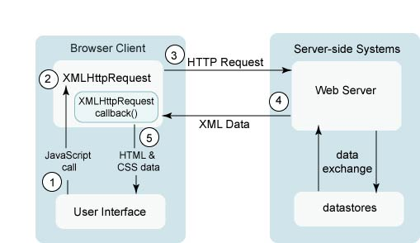
Introduction to How Does Ajax works?

Slide 35
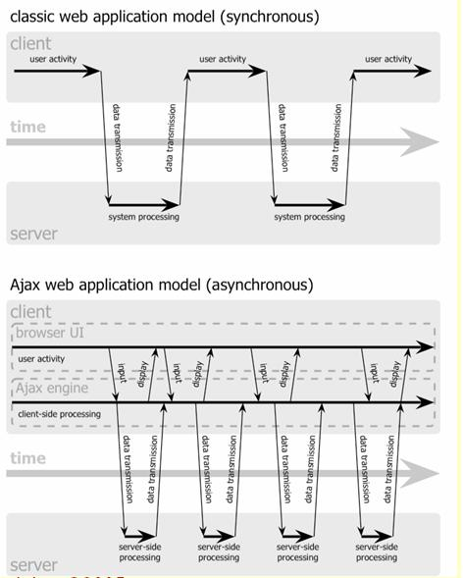
Introduction to Ajax How Does Ajax works? (contd..)
Interrupted user
operation while
the data is being
fetched
Uninterrupted
user operation
while data is
being fetched
Notes:
The user generates an event, such as by clicking a button. This results in a JavaScript call.
An XMLHttpRequest object is created and configured with a request parameter that includes the ID of the component that generated the event and any value that the user might have entered.
The XMLHttpRequest object makes an asynchronous request to the web server. An object (such as a servlet or listener) receives the request, processes it, and stores any data in the request to the data store. In the case of Ajax-aware JavaServer Faces components, the object that processes the request is a PhaseListener object. We'll cover that more later in the document.
The object that processed the request returns an XML document containing any updates that need to go to the client.
The XMLHttpRequest object receives the XML data, processes it, and updates the HTML DOM representing the page with the new data.
.

Slide 36
Introduction Technologies Used in AJAX
JavaScript.
  Loosely typed scripting language
  Allows programmatic interaction with the browser's capabilities
  JavaScript function is called when an event in a page occurs
DOM:
  API for accessing and manipulating structured documents.
  Represents the structure of XML and HTML documents
Notes:
.

Slide 37
Introduction Technologies Used in AJAX (contd..)
CSS
  Allows for a clear separation of the presentation from the content and may be changed programmatically by JavaScript
HTTP
  XMLHttpRequest
XML
  which represents the data passed between the server and client

Slide 38
Introduction t XML Http Request
JavaScript object
  Created within a JavaScript function
XMLHttpRequest object for asynchronously exchanging the XML data between the client and the server
Communicates with a server via standard HTTP GET/POST
XMLHttpRequest object works in the background
  Does not interrupt user operation

Slide 39
Introduction to Ajax
XML Http Request Methods
open(“method”, “URL”, syn/asyn)
  Assigns destination URL, method, mode
send(content)
  Sends request including string or DOM object data
abort()
  Terminates current request
Notes:
The open() Method
You call the open(DOMString method, DOMString uri, boolean async, DOMString username, DOMString password) method to initialize an XMLHttpRequest object. The method parameter is required and specifies the HTTP method (GET, POST, PUT, DELETE, or HEAD) that you want to use to send the request. To send data to the server, use the POST method. To retrieve data from the server, use the GET method. The uri parameter specifies the server URI to which the XMLHttpRequest object sends the request. The uri resolves to an absolute URI using the window.document.baseURI property—in other words, you can use relative URIs which will be resolved in the same way that the browser resolves relative URIs. The async parameter specifies whether the request is asynchronous; the default value is true. To send a synchronous request, set the parameter to false. For servers that require authentication, you can supply the optional username and password parameters. After calling the open() method, the XMLHttpRequest objects sets its readyState property to 1 (Open) and resets the responseText, responseXML, status, and statusText properties to their initial values. It also resets the request headers. Note that the object resets these values if you call the open() method when readyState is 4.
The send() Method
After preparing a request by calling the open() method, you send the request to the server. You may call send() only when the readyState value is 1, otherwise the XMLHttpRequest object raises an exception. The request gets sent to the server using the parameters supplied to the open() method. The send() method returns immediately when the async parameter is true, letting other client script processing continue. The XMLHttpRequest object sets the readyState value to 2 (Sent) after the send() method has been called. When the server responds, before receiving the message body, if any, the XMLHttpRequest object sets readyState to 3 (Receiving). When the request has completed loading it sets readyState to 4 (Loaded). For a request of type HEAD, it sets the readyState value to 4 immediately after setting it to 3.
The send() method takes an optional parameter that may contain data of varying types. Typically, you use this to send data to the server using the POST method. You can explicitly invoke the send() method with null, which is the same as invoking it with no argument. For most other data types, set the Content-Type header using the setRequestHeader() method (explained below) before invoking the send() method. If the data parameter in the send(data) method is of type DOMString, encode the data as UTF-8. If data is of type Document, serialize the data using the encoding specified by data.xmlEncoding, if supported or UTF-8 otherwise.

Slide 40
Introduction to Ajax
XML Http Request Methods (contd..)
getAllResponseHeaders()
  Returns headers (labels + values) as a string
getResponseHeader(“header”)
  Returns value of a given header
setRequestHeader(“label”,”value”)
  Sets Request Headers before sending
Notes:
The setRequestHeader() Method
The setRequestHeader(DOMString header, DOMString value) method sets request headers. You may call this method after calling the open() method—when the readyState value is 1—otherwise you'll get an exception.
The getResponseHeader() Method
You use getResponseHeader(DOMString header, value) method used to retrieve response header values. Call getResponseHeader() only when the readyState value is 3 or 4 (in other words, after the response headers are available); otherwise, the method returns an empty string.
The getAllResponseHeaders() Method
The getAllResponseHeaders() method returns all the response headers as a single string with each header on a separate line. The method returns null if readyState value is not 3 or 4.

Slide 41
Introduction to Ajax
XMLHttpRequest Properties
onreadystatechange
  Event handler that fires at each state change
  You implement your own function that handles this
readyState values – current status of request
  0 = uninitialized
  1 = loading
  2 = loaded
  3=interactive (some data has been returned)
  4=complete
Status
  HTTP Status returned from server: 200 = OK

Slide 42
Introduction to Ajax
XMLHttpRequest Properties (contd..)
responseText
  String version of data returned from server
responseXML
  XML DOM document of data returned
statusText
  Status text returned from server
Notes:
The responseText Property
The responseText property contains the text of the HTTP response received by the client. When the readyState value is 0, 1, or 2 responseText contains an empty string. When the readyState value is 3 (Receiving), the response contains the incomplete response received by the client. When readyState is 4 (Loaded) the responseText contains the complete response.
The responseXML Property
The responseXML property represents the XML response when the complete HTTP response has been received (when readyState is 4), when the Content-Type header specifies the MIME (media) type as text/xml, application/xml, or ends in +xml. If the Content-Type header does not contain one of these media types, the responseXML value is null. The responseXML value is also null whenever the readyState value contains any value other than 4.
The responseXML property value is an object of type Document interface, and represents the parsed document. If the document cannot be parsed (for example if the document is malformed or the character encoding of the document is not supported) the responseXML value is null.
The status Property
The status property represents the HTTP status code and is of type short. The status attribute is available only when the readyState value is 3 (Receiving) or 4 (Loaded). Attempting to access the status value when readyState is less than 3 raises an exception.
The statusText Property
The statusText attribute represents the HTTP status code text and is also available only when the readyState value is 3 or 4. Attempting to access the statusText property for other readyState values raises an exception.

Slide 43
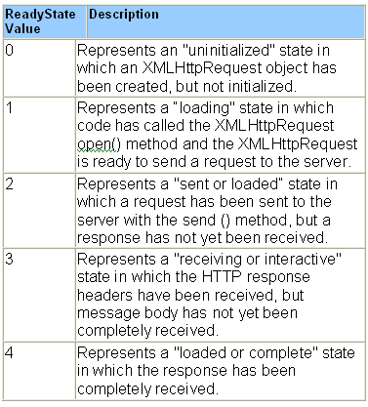
Introduction to Ajax
States of XMLHttpRequest
Notes:
The XMLHttpRequest object fires a readystatechange event whenever the readyState value changes.
The onreadystatechange property accepts an Event Listener value, specifying the method that the object will invoke whenever the readyState value changes.

Slide 44
Demo

Slide 45
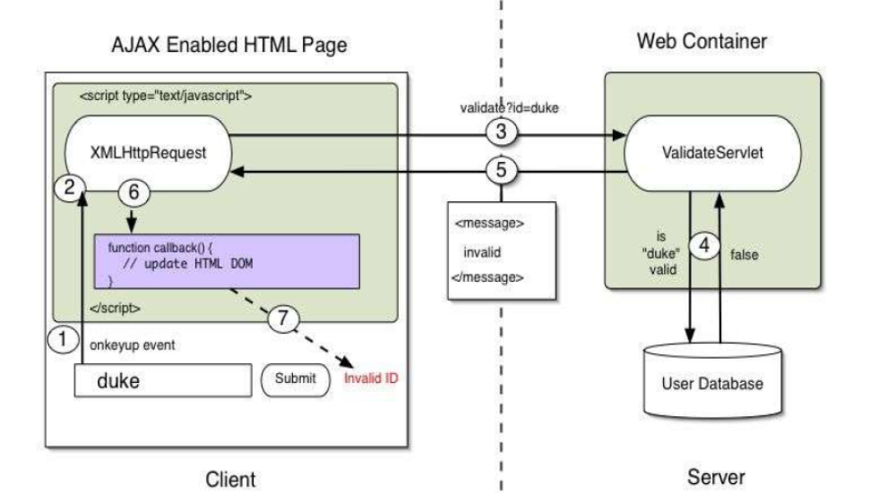
XMLHttpRequest Object
Ajax Interaction using XMLHttpRequest

Slide 46
XMLHttpRequest Object
Steps Of Interaction
A client event occurs
An XMLHttpRequest object is created
The XMLHttpRequest object is configured
The XMLHttpRequest object makes an async. Request
The request is processed by the ValidateServlet.
The ValidateServlet returns an XML document containing the result
The XMLHttpRequest object calls the callback() function and processes the result
The HTML DOM is updated

Slide 47
XMLHttpRequest Object
A Client event occurs
A JavaScript function is called as the result of an event
Example: validateUserId() JavaScript function is mapped to a onkeyup event on a link or form component
  <input type="text"
  size="20"
  id="userid"
  name="id"
  onkeyup="validateUserId();">

Slide 48
XMLHttpRequest Object
An XMLHttpRequest object is created and Configured
var req;
function initRequest(url) {
if (window.XMLHttpRequest) {
req = new XMLHttpRequest();
} else if (window.ActiveXObject) {
isIE = true;
req = new ActiveXObject("Microsoft.XMLHTTP");
}
} function validateUserId() {
if (!target) target = document.getElementById("userid");
var url = "validate?id=" + escape(target.value);
initRequest(url);
req.onreadystatechange = processRequest;
req.open("GET", url, true);
req.send(null);
}

Slide 49
An XMLHttpRequest object is configured with Callback function
var req;
function initRequest(url) {
if (window.XMLHttpRequest) {
req = new XMLHttpRequest();
} else if (window.ActiveXObject) {
isIE = true;
req = new ActiveXObject("Microsoft.XMLHTTP");
}
} function validateUserId() {
if (!target) target = document.getElementById("userid");
var url = "validate?id=" + escape(target.value);
initRequest(url);
req.onreadystatechange = processRequest;
req.open("GET", url, true);
req.send(null);
}

Slide 50
XMLHttpRequest Object
XMLHttpRequest object makes an async. request
var req;
function initRequest(url) {
if (window.XMLHttpRequest) {
req = new XMLHttpRequest();
} else if (window.ActiveXObject) {
isIE = true;
req = new ActiveXObject("Microsoft.XMLHTTP");
}
} function validateUserId() {
if (!target) target = document.getElementById("userid");
var url = "validate?id=" + escape(target.value);
initRequest(url);
req.onreadystatechange = processRequest;
req.open("GET", url, true);
req.send(null);
}
URL is set to validate?id=greg

Slide 51
The request is processed by the Validate Servlet at the Server
public class ValidationServlet extends HttpServlet {
private ServletContext context;
private HashMap accounts = new HashMap();
public void init(ServletConfig config) throws ServletException {
this.context = config.getServletContext();
accounts.put("greg","account data");
accounts.put("duke","account data");
}

Slide 52
The request is processed by the Validate Servlet at the Server (contd..)
public void doGet(HttpServletRequest request, HttpServletResponse response)
throws IOException, ServletException {
String targetId = request.getParameter("id");
if ((targetId != null) && !accounts.containsKey(targetId.trim())) {
response.setContentType("text/xml");
response.setHeader("Cache-Control", "no-cache");
response.getWriter().write("<valid>true</valid>");
} else {
response.setContentType("text/xml");
response.setHeader("Cache-Control", "no-cache");
response.getWriter().write("<valid>false</valid>");
} }

Slide 53
The ValidateServlet returns an XML document containing the results
public void doGet(HttpServletRequest request, HttpServletResponse
response)
throws IOException, ServletException {
String targetId = request.getParameter("id");
if ((targetId != null) && !users.containsKey(targetId.trim())) {
response.setContentType("text/xml");
response.setHeader("Cache-Control", "no-cache");
response.getWriter().write("valid");
} else {
response.setContentType("text/xml");
response.setHeader("Cache-Control", "no-cache");
response.getWriter().write("invalid");
} } }

Slide 54
XML Http Request object calls callback() function and processes the result
The XMLHttpRequest object was configured to call the processRequest() function when there are changes to the readyState of the XMLHttpRequest object
  -function processRequest() {
  if (req.readyState == 4) {
  if (req.status == 200) {
  var message =
  req.responseXML.getElementsByTagName("valid")[0].childNo
  des[0].nodeValue;
  setMessageUsingDOM(message);
  ...
Notes:
Browser and DOM
Browsers maintain an object representation of the documents being displayed
In the form of Document Object Model (DOM)
JavaScript technology in an HTML page has access to the DOM
APIs are available that allow JavaScript technology to modify the DOM programmatically
Object Representation of the XML
Document Retrieved
Following a successful request, JavaScript technology code may modify the DOM of the HTML page
The object representation of the XML document that was retrieved from the ValidateServlet is available to JavaScript technology code using the req.responseXML, where req is an XMLHttpRequest object
DOM APIs for Navigation
DOM APIs provide a means for JavaScript technology to navigate the content from that document and use that content to modify the DOM of the HTML page
<message> valid </message>
function parseMessage() {
var message =
req.responseXML.getElementsByTagName("message")[0];
setMessage(message.childNodes[0].nodeValue);
}

Slide 55
XMLHttpRequest Object
The HTML DOM is updated
JavaScript technology can gain a reference to any element in the HTML DOM using a number of APIs
The recommended way to gain a reference to an element is to call
  -document.getElementById("userIdMessage"), where "userIdMessage" is the ID attribute of an element appearing in the HTML document
JavaScript technology may now be used to modify the element's attributes; modify the element's style properties; or add, remove, or modify child elements

Slide 56
XMLHttpRequest Object
The HTML DOM is updated (contd..)
<script type="text/javascript">
function setMessage(message) {
mdiv = document.getElementById("userIdMessage");
if (message == "invalid") {
mdiv.innerHTML = "<div style=\"color:red\">Invalid User Id</
div>";
} else {
mdiv.innerHTML = "<div style=\"color:green\">Valid User Id</
div>";
}
}
</script>
<body>
<div id="userIdMessage"></div>
</body>

Slide 57
XMLHttpRequest Object
Change the Body content of an Element
<script type="text/javascript">
function setMessage(message) {
mdiv = document.getElementById("userIdMessage");
if (message == "invalid") {
mdiv.innerHTML = "<div style=\"color:red\">Invalid User Id</
div>";
} else {
mdiv.innerHTML = "<div style=\"color:green\">Valid User Id</
div>";
}
}
</script>
<body>
<div id="userIdMessage"></div>
</body>

Slide 58
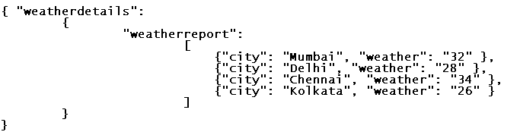

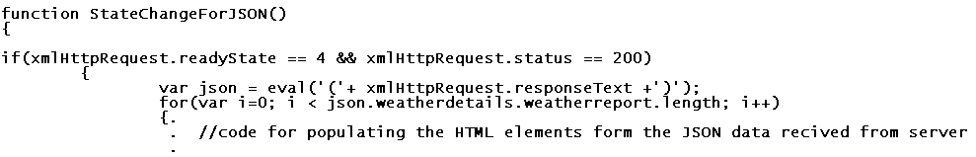
Ajax using JSON
JSON data
Configuring ajax Request and initializing
Receiving JSON data using XMLHttpRequest object

Slide 59
2 . XMLHttpRequest Object
2.4 Demo on XMLHttpRequest

